Slide 1

Floor Planning via
Convex Optimization
Final Projection - EEC 254 (Winter 2018)
^{By: Ahmed Mahmoud}

Slide 2
Agenda
Problem Definition & Motivation (3 mins)
Background (1 mins)
Problem Formulation (4 mins)
Project Goal(s) (2 mins)

Slide 3
Problem Definition
Configure some rectangles within a bounding box
Objective function is on the bounding box
Constraints is on the shape and size of rectangles
Fig: show some rectangles
Fig: show them within a BB
Fig: show skinny rectangles
Fig: change the position and size to show different configuration
Notes:
In floor planning problem, we have some rectangles that are to configured and placed in a such a way that they do not overlap. The objective is usually to minimize the area of the bounding box, which is the smallest rectangle that contains the rectangles to be configured and placed. Each rectangle can be reconfigured, within some limits. For example, we might fix the area of each rectangle, but not the width and height separately (this might give very skinny rectangles so we might also limit the aspect ratio to be within some limits).

Slide 4
Problem Definition
Constraints:
no overlap
relative position
Notes:
The constraints always starts with ensuring no overlap between rectangles, but only having this constraint makes the problem complicated combinatorial optimization. For that we add more constraints that help us making the problem a convex optimization one like relative position, so you specify that rectangle A is to be to the left of rectangle B which should be on the top of rectangle C and so on. This can be constructed using a pair of graphs (one for the horizontal relative position and one for the vertical relative position).

Slide 5
Problem Definition
4
Constraints:
no overlap
relative position
5
1
3
2
4
5
5
1
3
3
4
2
1
2
Vertical Graph
Horizontal Graph
Notes:
The constraints always starts with ensuring no overlap between rectangles, but only having this constraint makes the problem complicated combinatorial optimization. For that we add more constraints that help us making the problem a convex optimization one like relative position, so you specify that rectangle A is to be to the left of rectangle B which should be on the top of rectangle C and so on. This can be constructed using a pair of graphs (one for the horizontal relative position and one for the vertical relative position).

Slide 6
Problem Definition
Constraints:
no overlap
relative position (implies no overlap)
all rectangles inside the bounding box
minimum rectangle area/aspect ratio/perimeter
symmetry
alignment
similarity
Notes:
The constraints always starts with ensuring no overlap between rectangles, but only having this constraint makes the problem complicated combinatorial optimization. For that we add more constraints that help us making the problem a convex optimization one like relative position, so you specify that rectangle A is to be to the left of rectangle B which should be on the top of rectangle C and so on. This can be constructed using a pair of graphs (one for the horizontal relative position and one for the vertical relative position).
Giving the relative positions implies the non-overlap constraints. Of course you want all the rectangles to be inside the bounding box. Additional constraints could include the shape and size of the rectangles like their minimum area, aspect ratio (which is the ratio of the length to the width of the rectangles) or the perimeter. It may be needed to have some symmetry along a certain axis of the bounding box (for aesthetic purpose) or alignment between some of the rectangles. Alignment could be along the edges of the rectangles or their centers. Similarity between the rectangles simply means that rectangle A is within a scaling factor of rectangle B.

Slide 7
Problem Definition
Objective:
minimize the size (area, perimeter) of the bounding box
or, maximize the size of the rectangles given a fixed bounding box
Variables:
rectangles’ positions
rectangles’ sizes
bounding box size
Notes:
The objectives we are dealing with here could be either to minimize the size of the bounding box, or having a bounding box with fixed size inside which we are trying to maximize the size of the rectangles. By size here I mean the area or the perimeter. And the variables we are allowed to change is the rectangle positions and their length and width. We are also allowed to change the bounding box width and height.

Slide 8
Motivation
Architecture:
the rectangles are rooms/floors
arrange rooms within fixed bounding box
VLSI:
minimize the area of the blocks which decompose a circuit
Notes:
The two fields that are interested in solving this problem is Architecture and VLSI design. In architecture the rectangles are the rooms are constrained to have a minimum and/or maximum area and the walls should be aligned in certain way. The area of the bounding box is usually fixed so the objective here is to maximize the size of the rooms and utilize the whole area of the bounding box while making sure all constraints are satisfied.
In VLSI design, millions of logic components that build up a circuit are partitioned into blocks. These blocks have a minimum area defined by the component from which it is built up. The goal here is to place the blocks so that the area of the chip is minimized and certain placement constraints are respected (most importantly to have certain clearance between different components).

Slide 9
Background
IDK:
Really!!!

Slide 10
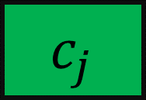
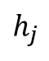
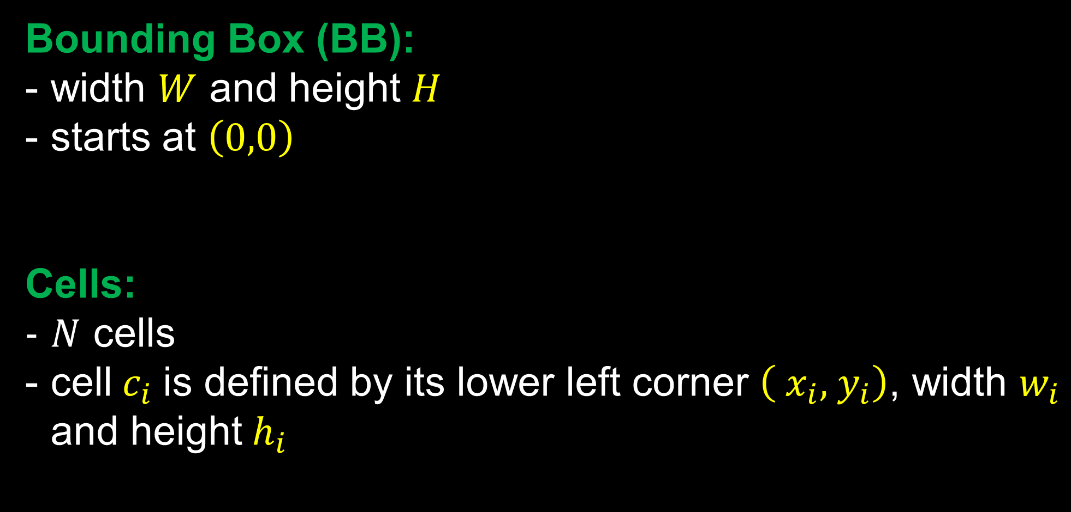
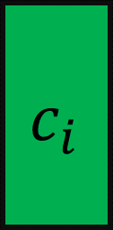
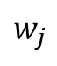
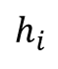
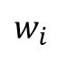
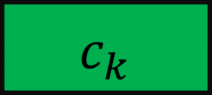
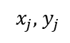
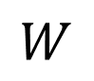
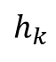
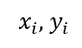
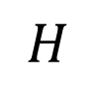
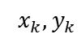
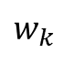
Formulation
BB
$${ c}_{k}$$
Bounding Box (BB):
width $W$ and height $H$
starts at $\left(0,0\right)$
Cells:
$N$ cells
cell${ c}_{i}$ is defined by its lower left corner $\left({ x}_{i},{ y}_{i}\right)$, width $w_{i}$ and height${ h}_{i}$
$$h_{k}$$
$${ x}_{k},{ y}_{k}$$
$$w_{k}$$
$${ c}_{i}$$
$$H$$
$$h_{i}$$
$$h_{j}$$
$${ c}_{j}$$
$${ x}_{j},{ y}_{j}$$
$$w_{j}$$
$${ x}_{i},{ y}_{i}$$
$$w_{i}$$
$$W$$
Notes:
The formulation starts by defining a bonding box that will contains all the cells. The BB will starts at (0,0) with width W and height H. We will have N cells, each defined by their lower left corner and their width and height.

Slide 11
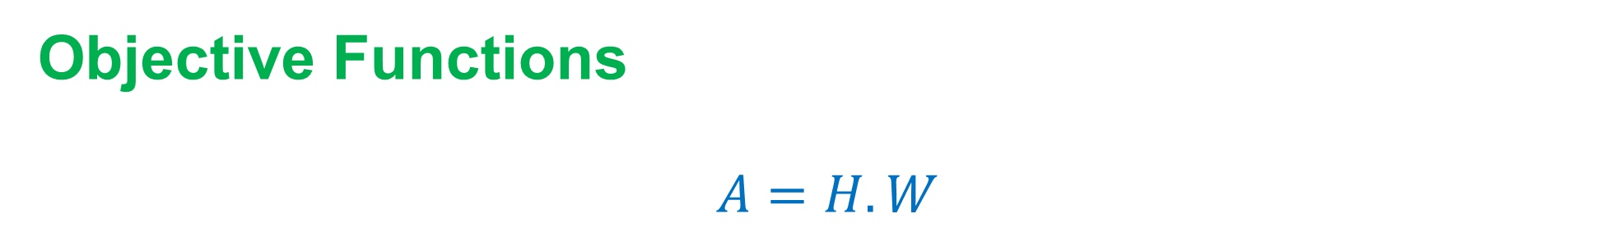
Formulation
Objective Functions
Minimize BB area:
$A=H.W$
Notes:
The first objective function we can deal with is the area of the bounding box

Slide 12
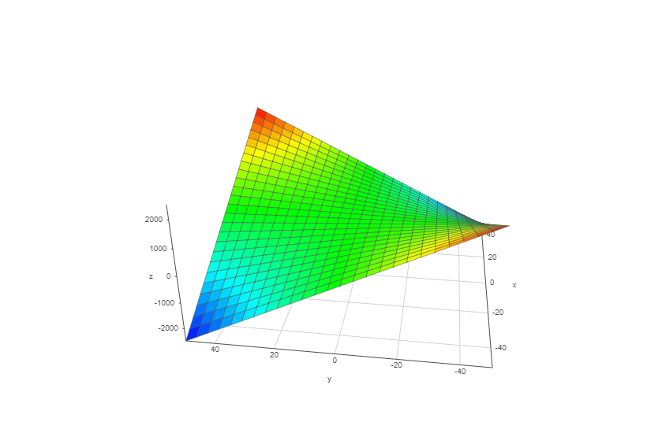
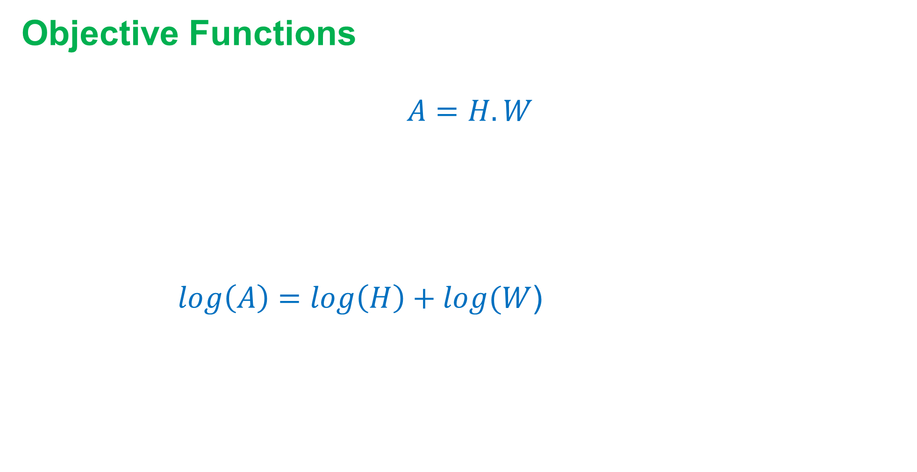
Formulation
Objective Functions
Minimize BB area:
$A=H.W$
Hessian’s minimum eigenvalue <0 non-convex
Take $log$
$log\left(A\right)=\log\left(H\right)+log⁡(W$) concave
Notes:
The function is non convex actually since the hessian as minimum eigenvalue less than zero and so it is not positive semi-definite.
Instead we can take the log of this function and the resulting function is concave, but still we want to minimize this function (not maximize) and so it does not fit into the standard convex optimization formulation.

Slide 13
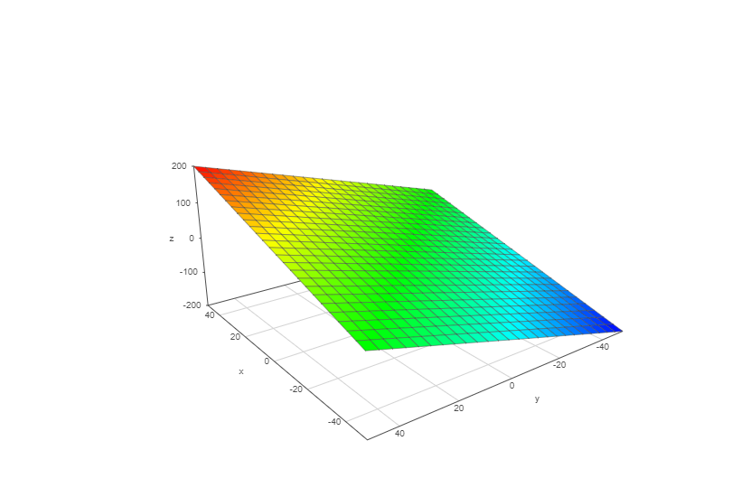
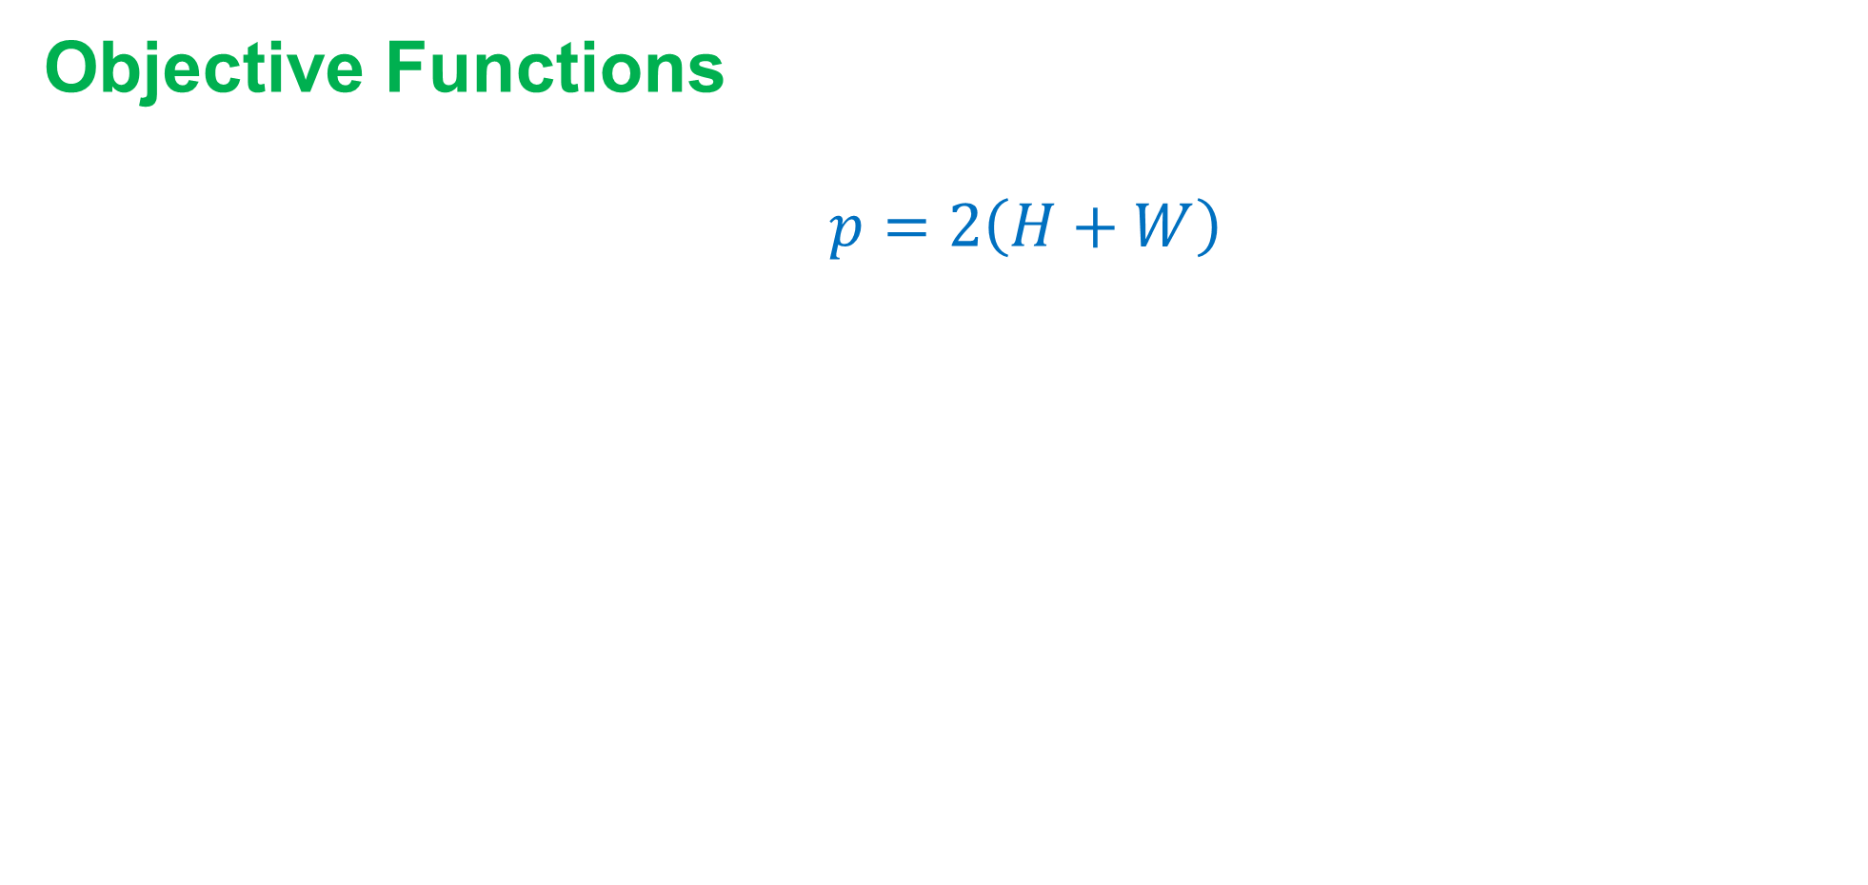
Formulation
Objective Functions
Minimize BB perimeter:
$p=2\left(H+W\right)$
Affine, tend to form equal sides BB
Notes:
Instead we will use the perimeter as the objective when we want to minimize the size of the bounding box which is affine function and looks way nicer than the area function. Additionally, since minimizing the area could lead to very skinny BB, minimizing the perimeter tend actually to have equal sides which is preferred for VLSI design.

Slide 14
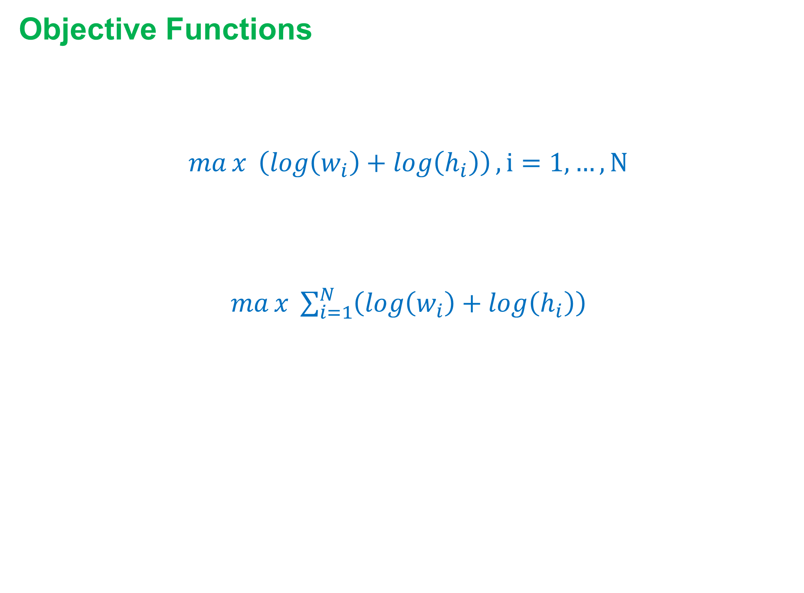
Formulation
Objective Functions
Maximize cells area:
concave function
$max{ \left(\log\left(w_{i}\right)+\log\left(h_{i}\right)\right)}, i=1,…, N$
multi-criterion with $N$ objective function
scalarization
$max{ \sum_{i=1}^{N}{\left(\log\left(w_{i}\right)+\log\left(h_{i}\right)\right)}}$
Notes:
The other objective function that we may want to work on is the the area of the cells and we usually want to maximize it. Using the log area, and since its concave and we want to maximize it, then it can fit in the standard convex optimization formulation. The problem is then a multi-criterion problem with N objective function. We can do scalarization to this function by choosing to maximize the sum of all area.

Slide 15
Formulation
Constraints
Basic constraints:
Notes:
We now move to talk about the constraints. Not all the constraints I am going to talk about are necessary. For that we start with the basic constraints and then move to optional constraints.

Slide 16
Formulation
Constraints
No overlap:

Slide 17
Formulation
Constraints
Minimum area:

Slide 18
Formulation
Constraints
Aspect ratio:

Slide 19
Formulation
Constraints
Alignment:

Slide 20
Formulation
Constraints
Symmetry:

Slide 21
Formulation
Constraints
Containment:

Slide 22
Formulation
Primal Problem
Containment:

Slide 27
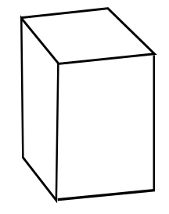
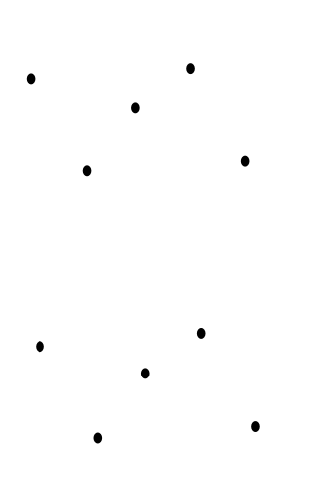
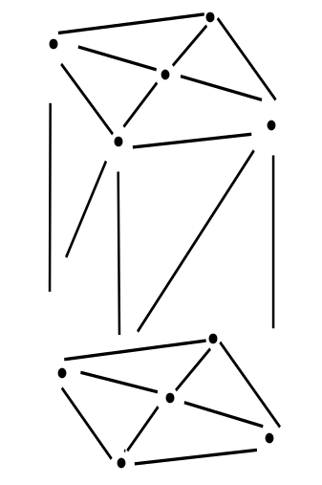
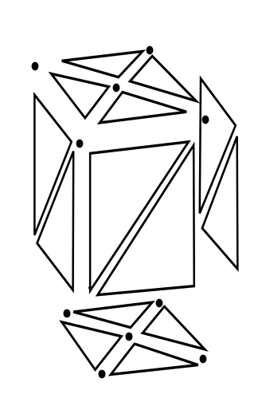
Motivation
- A mesh is vertices connected by edges to compose faces that decomposed some a subset of a domain
connected
form
approximate
by
Vertices
Edges
Faces
Domain subset
Credits: Wikipedia
Notes:
Polygonal mesh is defined as set of vertices in some domain along with their connectivity. Examples include, triangular or quad mesh in 2d. If 3d, they become tetrahedron and hexahedron meshes. Further we can have a 2d mesh that is mapped or embedded in 3d domain. It is referred to as ‘curved surface’ mesh. One thing that differ mesh from having just a bunch of vertices with random connectivity is meshes should not have overlapping face or intersecting elements.
To two main uses of meshes are visualization and manipulation of objects for computer graphics applications and numerical solution like Finite Element for partial differential equations.

Slide 28
Background
- A mesh is vertices connected by edges to compose faces that decomposed some a subset of a domain
connected
form
approximate
by
Vertices
Edges
Faces
Domain subset
Credits: Wikipedia
Notes:
Polygonal mesh is defined as set of vertices in some domain along with their connectivity. Examples include, triangular or quad mesh in 2d. If 3d, they become tetrahedron and hexahedron meshes. Further we can have a 2d mesh that is mapped or embedded in 3d domain. It is referred to as ‘curved surface’ mesh. One thing that differ mesh from having just a bunch of vertices with random connectivity is meshes should not have overlapping face or intersecting elements.
To two main uses of meshes are visualization and manipulation of objects for computer graphics applications and numerical solution like Finite Element for partial differential equations.

Slide 29
Formulation
- A mesh is vertices connected by edges to compose faces that decomposed some a subset of a domain
connected
form
approximate
by
Vertices
Edges
Faces
Domain subset
Credits: Wikipedia
Notes:
Polygonal mesh is defined as set of vertices in some domain along with their connectivity. Examples include, triangular or quad mesh in 2d. If 3d, they become tetrahedron and hexahedron meshes. Further we can have a 2d mesh that is mapped or embedded in 3d domain. It is referred to as ‘curved surface’ mesh. One thing that differ mesh from having just a bunch of vertices with random connectivity is meshes should not have overlapping face or intersecting elements.
To two main uses of meshes are visualization and manipulation of objects for computer graphics applications and numerical solution like Finite Element for partial differential equations.

Slide 30
Goals
- A mesh is vertices connected by edges to compose faces that decomposed some a subset of a domain
connected
form
approximate
by
Vertices
Edges
Faces
Domain subset
Credits: Wikipedia
Notes:
Polygonal mesh is defined as set of vertices in some domain along with their connectivity. Examples include, triangular or quad mesh in 2d. If 3d, they become tetrahedron and hexahedron meshes. Further we can have a 2d mesh that is mapped or embedded in 3d domain. It is referred to as ‘curved surface’ mesh. One thing that differ mesh from having just a bunch of vertices with random connectivity is meshes should not have overlapping face or intersecting elements.
To two main uses of meshes are visualization and manipulation of objects for computer graphics applications and numerical solution like Finite Element for partial differential equations.

Slide 31
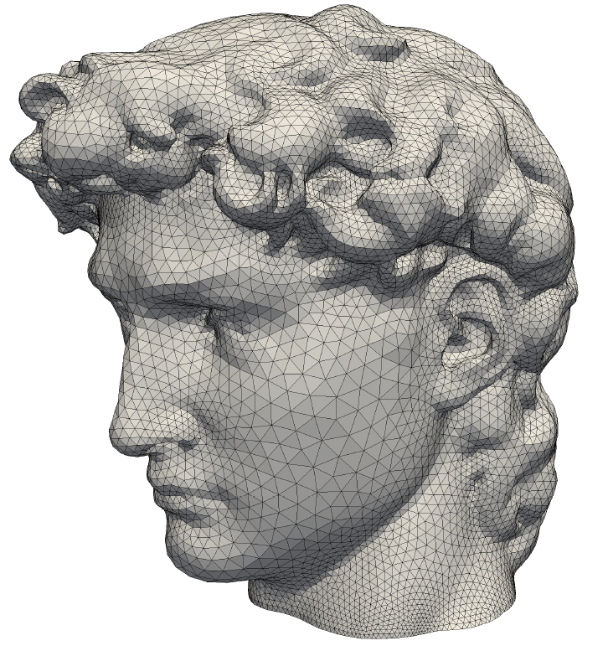
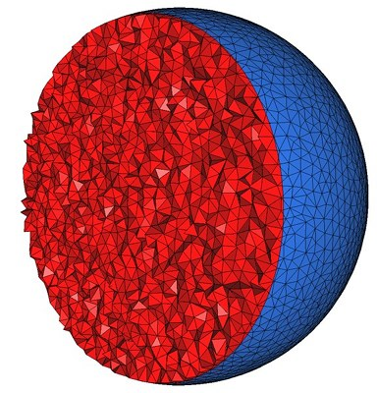
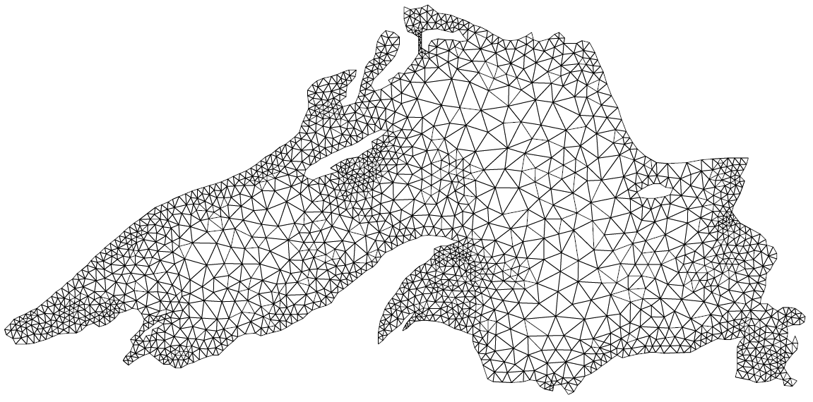
Mesh
- The domain subset we are trying to approximate could be 2D domain, 2D domain embedded in 3D or 3D domain
2D Domain
Curved surface
2D embedded in 3D
3D Domain
Credits: CGAL
Notes:
Polygonal mesh is defined as set of vertices in some domain along with their connectivity. Examples include, triangular or quad mesh in 2d. If 3d, they become tetrahedron and hexahedron meshes. Further we can have a 2d mesh that is mapped or embedded in 3d domain. It is referred to as ‘curved surface’ mesh. One thing that differ mesh from having just a bunch of vertices with random connectivity is meshes should not have overlapping face or intersecting elements.
To two main uses of meshes are visualization and manipulation of objects for computer graphics applications and numerical solution like Finite Element for partial differential equations.

Slide 32
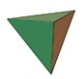
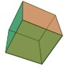
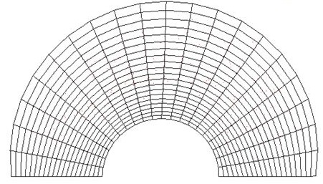
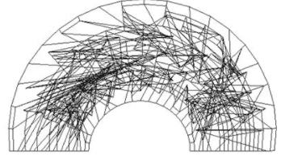


Mesh
- Faces are most commonly triangles or quad
- In 3D, they becomes tetrahedron and hexahedrons
- Do not allow overlapping faces or intersecting elements.
Notes:
Polygonal mesh is defined as set of vertices in some domain along with their connectivity. Examples include, triangular or quad mesh in 2d. If 3d, they become tetrahedron and hexahedron meshes. Further we can have a 2d mesh that is mapped or embedded in 3d domain. It is referred to as ‘curved surface’ mesh. One thing that differ mesh from having just a bunch of vertices with random connectivity is meshes should not have overlapping face or intersecting elements.
To two main uses of meshes are visualization and manipulation of objects for computer graphics applications and numerical solution like Finite Element for partial differential equations.

Slide 33
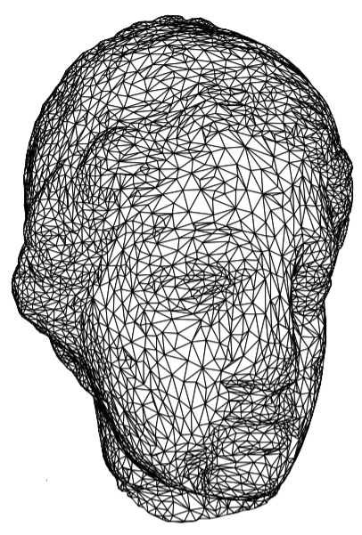
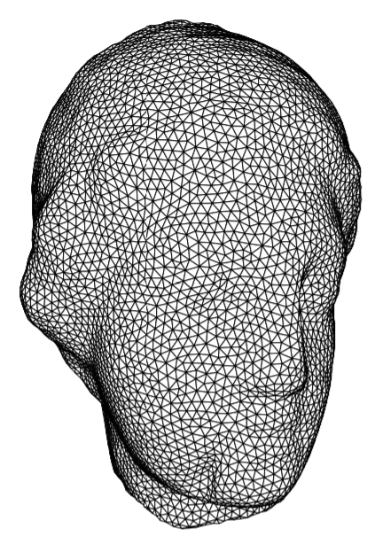

Remeshing
- Turning an input low-quality mesh into a high-quality one
- Quality is based on the application
- Common desirable quality: regularity
Interactive Geometry
Remeshing –
Alliez ,et al.
2002
Notes:
So, this is a general idea for the mesh/meshing. So now the questions is what is remeshing? So remeshing is a process of taking an input mesh have some low quality and produces another mesh that describes the same shape or domain but higher quality. The quality we try to improve depends on the application. For example, for computer graphics, it is always desirable to have a mesh with as few as possible vertex count. In that case we can define the quality as vertex count and we try to minimize this value as much as possible within some constraints on the how representative the output mesh going to be.
For numerical solutions, the quality is described usually in terms of the shape of a single element e.g., the angle bounds, edge length. It is always preferred to have a mesh consists of equilateral triangles to guarantee a fast convergence for the numerical solution. But this is usually hard to obtain for complex models and there is no proof that it is possible to obtain equilateral triangles for arbitrary shapes even in 2d. A more relaxed quality is convert an input mesh into non-obtuse one i.e., having all angles less than or equal 90. There is a proof that it is possible to always obtain non-obtuse triangulation for arbitrary shapes in 2d but there is no working algorithm for that. And this last one is what we will try to solve in this project.

Slide 34
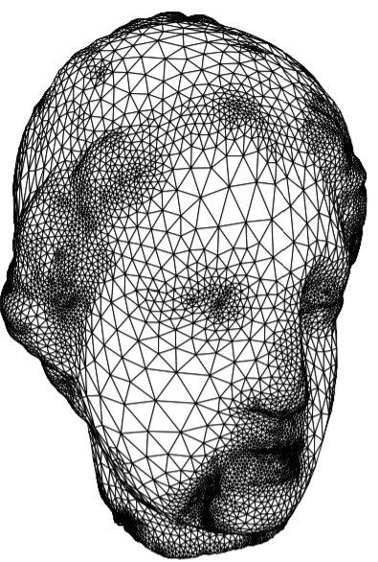
Remeshing
- Turning an input low-quality mesh into a high-quality one
- Quality is based on the application
- Common desirable quality: vertex count
Interactive Geometry
Remeshing –
Alliez ,et al.
2002
Notes:
So, this is a general idea for the mesh/meshing. So now the questions is what is remeshing? So remeshing is a process of taking an input mesh have some low quality and produces another mesh that describes the same shape or domain but higher quality. The quality we try to improve depends on the application. For example, for computer graphics, it is always desirable to have a mesh with as few as possible vertex count. In that case we can define the quality as vertex count and we try to minimize this value as much as possible within some constraints on the how representative the output mesh going to be.
For numerical solutions, the quality is described usually in terms of the shape of a single element e.g., the angle bounds, edge length. It is always preferred to have a mesh consists of equilateral triangles to guarantee a fast convergence for the numerical solution. But this is usually hard to obtain for complex models and there is no proof that it is possible to obtain equilateral triangles for arbitrary shapes even in 2d. A more relaxed quality is convert an input mesh into non-obtuse one i.e., having all angles less than or equal 90. There is a proof that it is possible to always obtain non-obtuse triangulation for arbitrary shapes in 2d but there is no working algorithm for that. And this last one is what we will try to solve in this project.

Slide 35
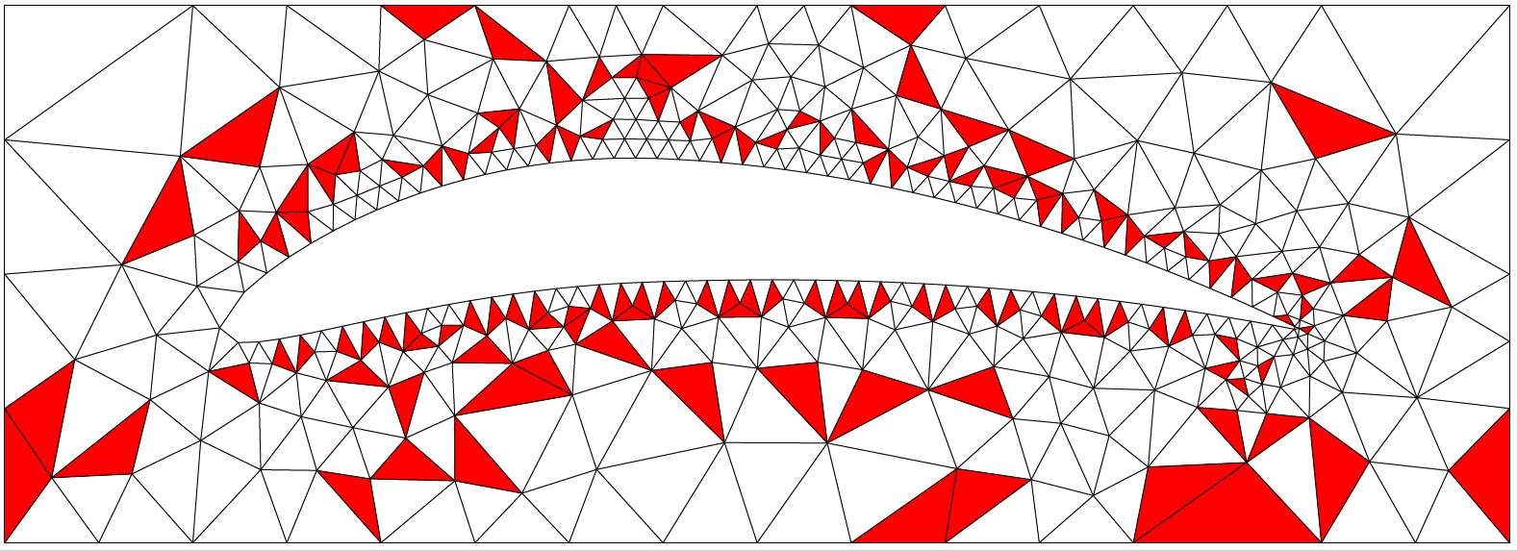
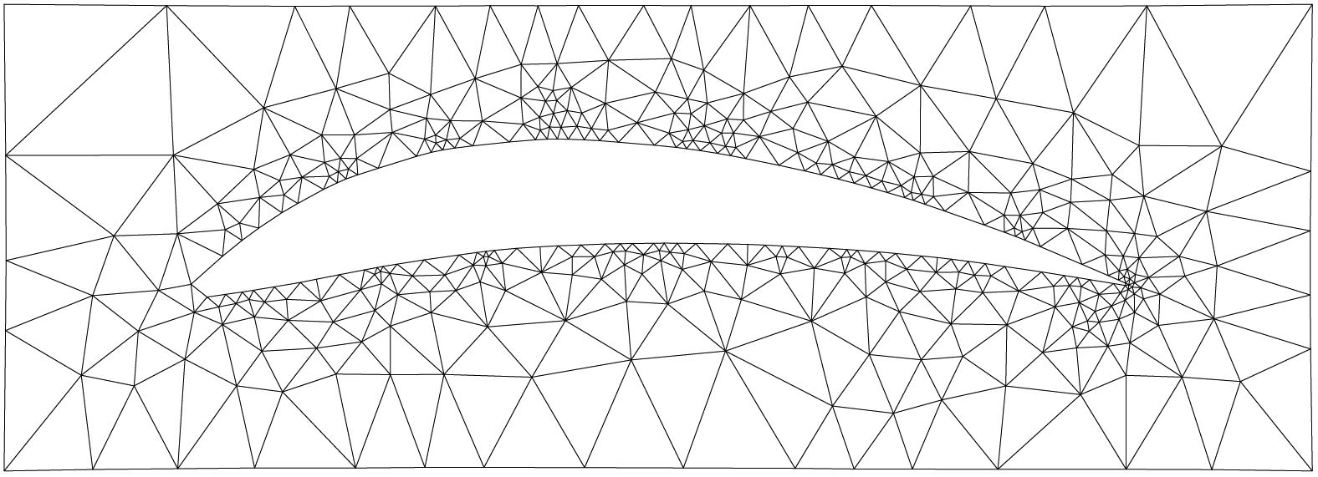
Remeshing
- Turning an input low-quality mesh into a high-quality one
- Quality is based on the application
- Common desirable quality: non-obtuse triangles
Red = obtuse triangle
Notes:
So, this is a general idea for the mesh/meshing. So now the questions is what is remeshing? So remeshing is a process of taking an input mesh have some low quality and produces another mesh that describes the same shape or domain but higher quality. The quality we try to improve depends on the application. For example, for computer graphics, it is always desirable to have a mesh with as few as possible vertex count. In that case we can define the quality as vertex count and we try to minimize this value as much as possible within some constraints on the how representative the output mesh going to be.
For numerical solutions, the quality is described usually in terms of the shape of a single element e.g., the angle bounds, edge length. It is always preferred to have a mesh consists of equilateral triangles to guarantee a fast convergence for the numerical solution. But this is usually hard to obtain for complex models and there is no proof that it is possible to obtain equilateral triangles for arbitrary shapes even in 2d. A more relaxed quality is convert an input mesh into non-obtuse one i.e., having all angles less than or equal 90. There is a proof that it is possible to always obtain non-obtuse triangulation for arbitrary shapes in 2d but there is no working algorithm for that. And this last one is what we will try to solve in this project.

Slide 36
Problem Statement
Given an input mesh, modify it such that no angle is greater than 90⁰. It is allowed to move vertices, add vertices and remove vertices. Additionally, try to use as few vertices as possible.
Notes:
So, from this, we can state the problem as having an input mesh with some obtuse triangles and we want to “remesh” by eliminating all obtuse triangles. The constraints we have here is to represent the same shape of course and to have the same sizing function. So, usually measure the sizing function by the edge length. So you can imagine there is some continuous function lives on the top of the mesh and at each point we can measure what is the maximum edge length allowed and we should not allow any edge connected to this vertex to be longer that this value.
We are also allowed to move the vertices, add more vertices or remove vertices in order to eliminate obtuse triangles. However, it is more preferable to have as few as possible number of vertices.

Slide 37
Solution
1) Iterate over all mesh elements
2) Select an element with low quality (obtuse triangle)
3) Apply one of the remeshing operator
- guarantee to not create another bad element
- will either fix this element or leave it as it is
4) Move on to another bad elements and apply 3)
5) Keep iterating until all elements are fixed or reach maximum number of iterations
Notes:
So our solution consists of iterating over all mesh elements (triangles). Select an element with low quality. Apply what we call remeshing operator on it.

Slide 38
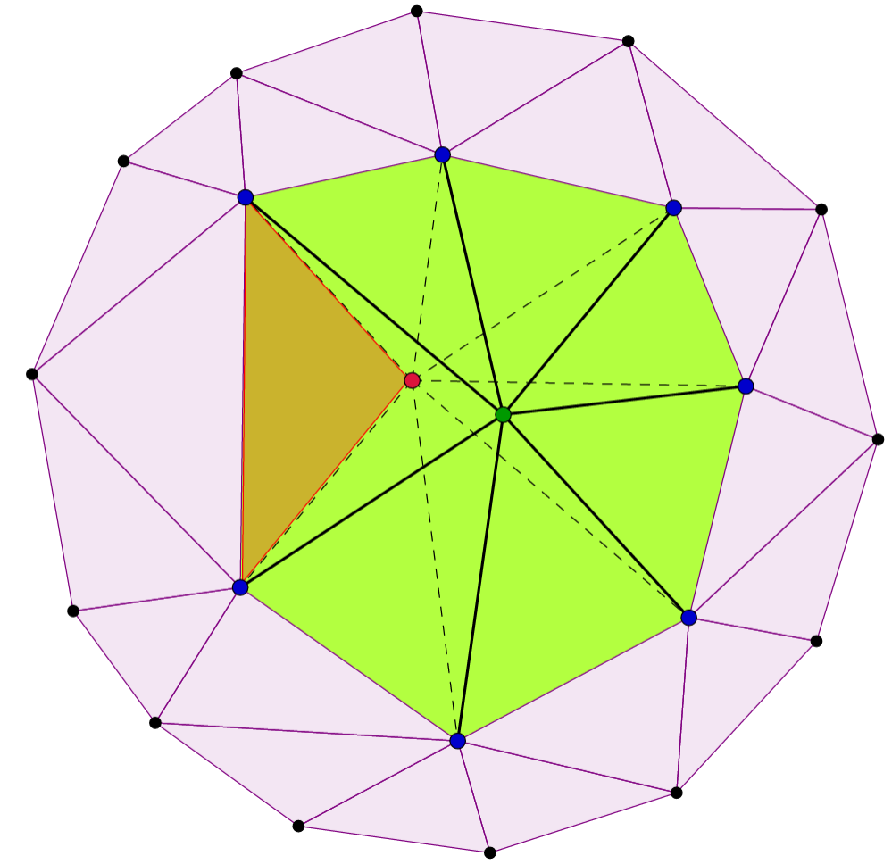
Solution
Remeshing operator
1) Relocation
Red = bad element
Dotted edges = before
Solid edges = after
Notes:
So our solution consists of iterating over all mesh elements (triangles). Select an element with low quality. Apply what we call remeshing operator on it.

Slide 39
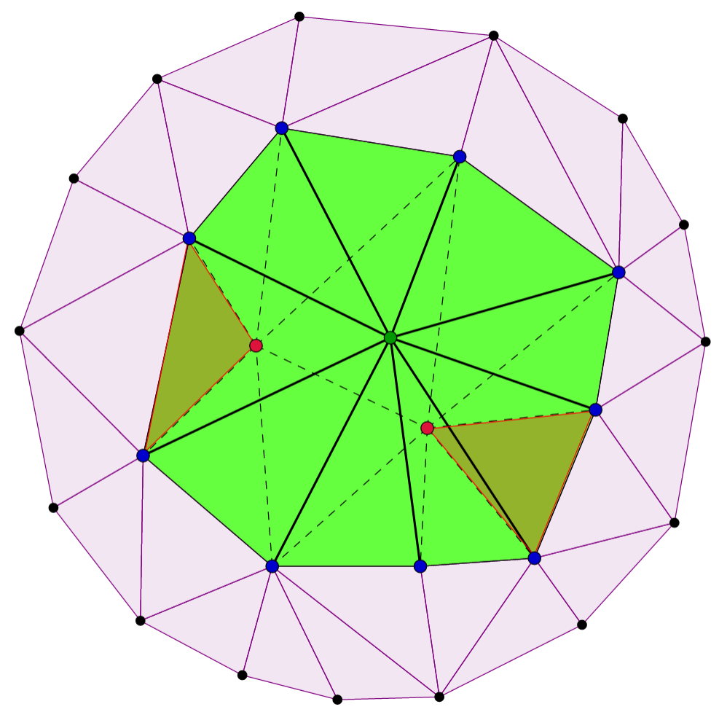
Solution
Remeshing operator
2) Ejection
Red = bad element
Dotted edges = before
Solid edges = after
Notes:
So our solution consists of iterating over all mesh elements (triangles). Select an element with low quality. Apply what we call remeshing operator on it.

Slide 40
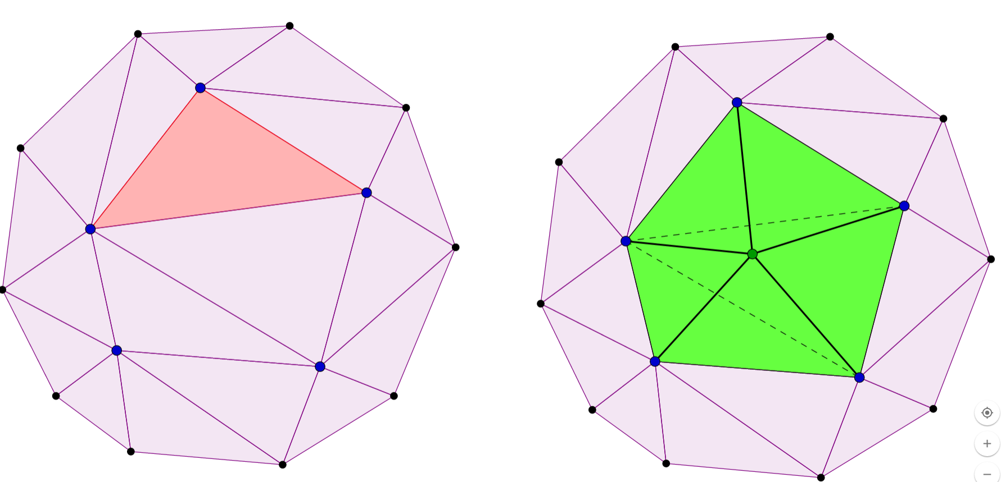
Solution
Remeshing operator
3) Injection
Red = bad element
Dotted edges = before
Solid edges = after
Notes:
So our solution consists of iterating over all mesh elements (triangles). Select an element with low quality. Apply what we call remeshing operator on it.

Slide 41
RL for Remeshing: idea
- Operators scheduling is done statically such that one operator is applied to all low-quality elements before trying another operator
- Dynamic scheduling via RL:
Environment -> input mesh
Agent -> picks operators
Reward -> 1 for non-obtuse everywhere, 0 otherwise
Notes:
So our solution consists of iterating over all mesh elements (triangles). Select an element with low quality. Apply what we call remeshing operator on it.

Slide 42
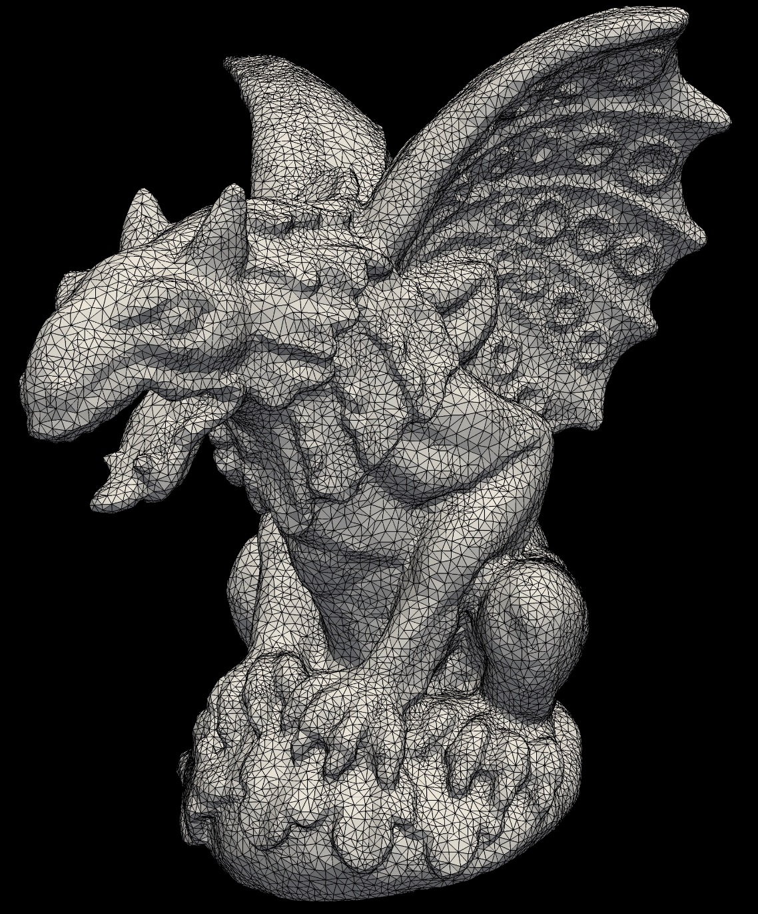
Thank You!

Slide 43
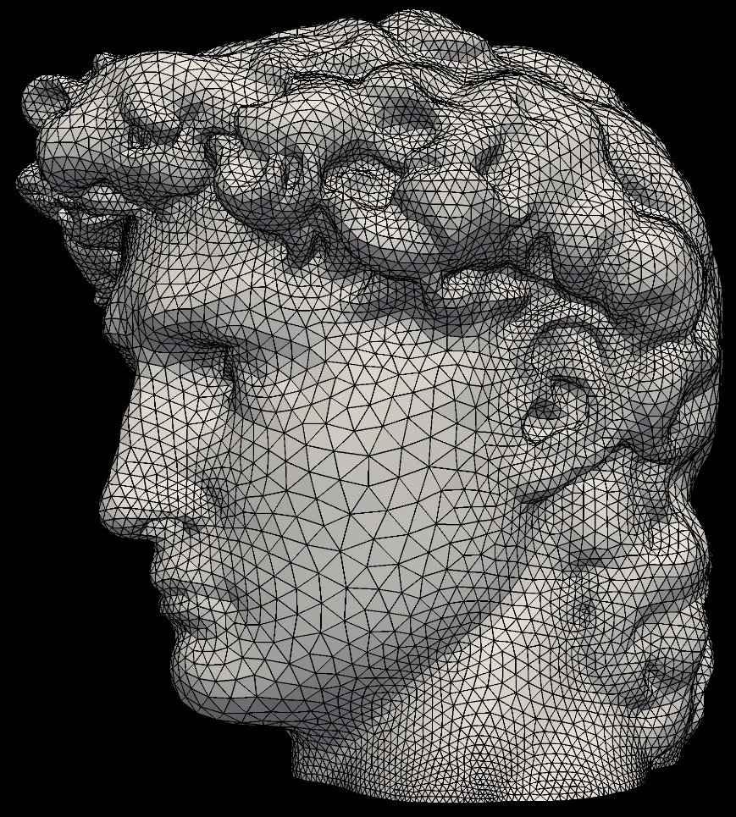
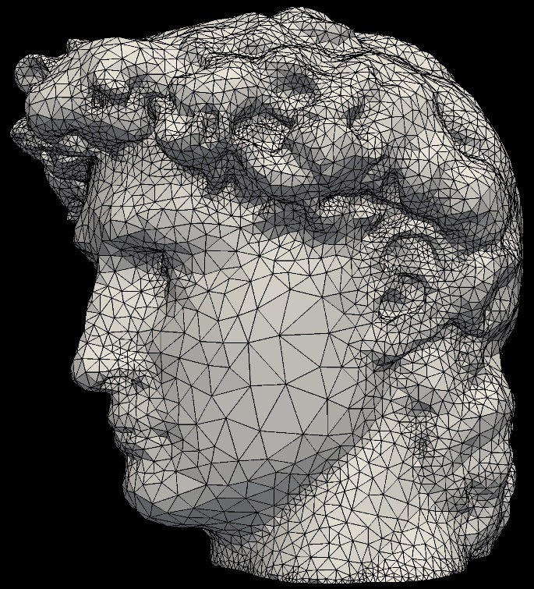
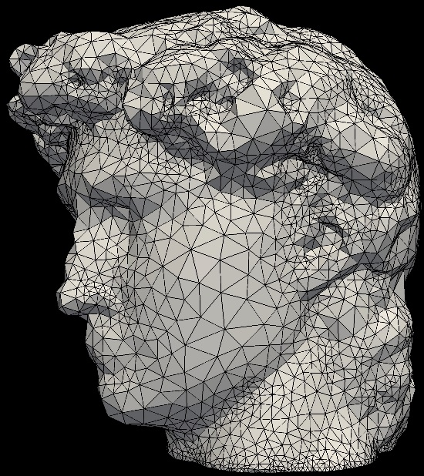
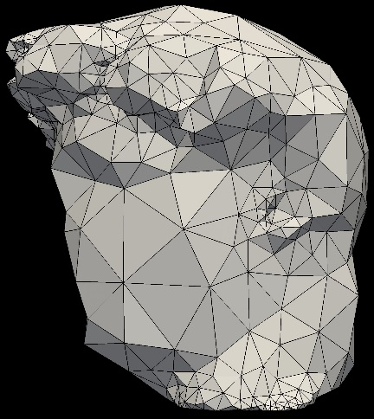
Applications
4- Mesh Simplification
Level Of Details (LOD)
15K #vertex
9.5K #vertex
4.5K #vertex
0.6K #vertex
Notes:
Mesh Simplification results (Section 5.2)
The Delaunay Sifting application can be used in order to reduce the mesh complexity while preserving almost all the details of the input models along with the quality in terms of angle bounds, sizing function, etc. Sometimes a user might desire to achieve Level Of Details (LOD) where higher reduction ratio is desired. This is also called mesh simplification. Our strategy can be tweaked in order to achieve such LOD by tolerating higher variation in smoothness. Our mesh simplification differs in that it preserves the quality of the input mesh in terms of angle bounds, Delaunay property, and others qualities.

Slide 44
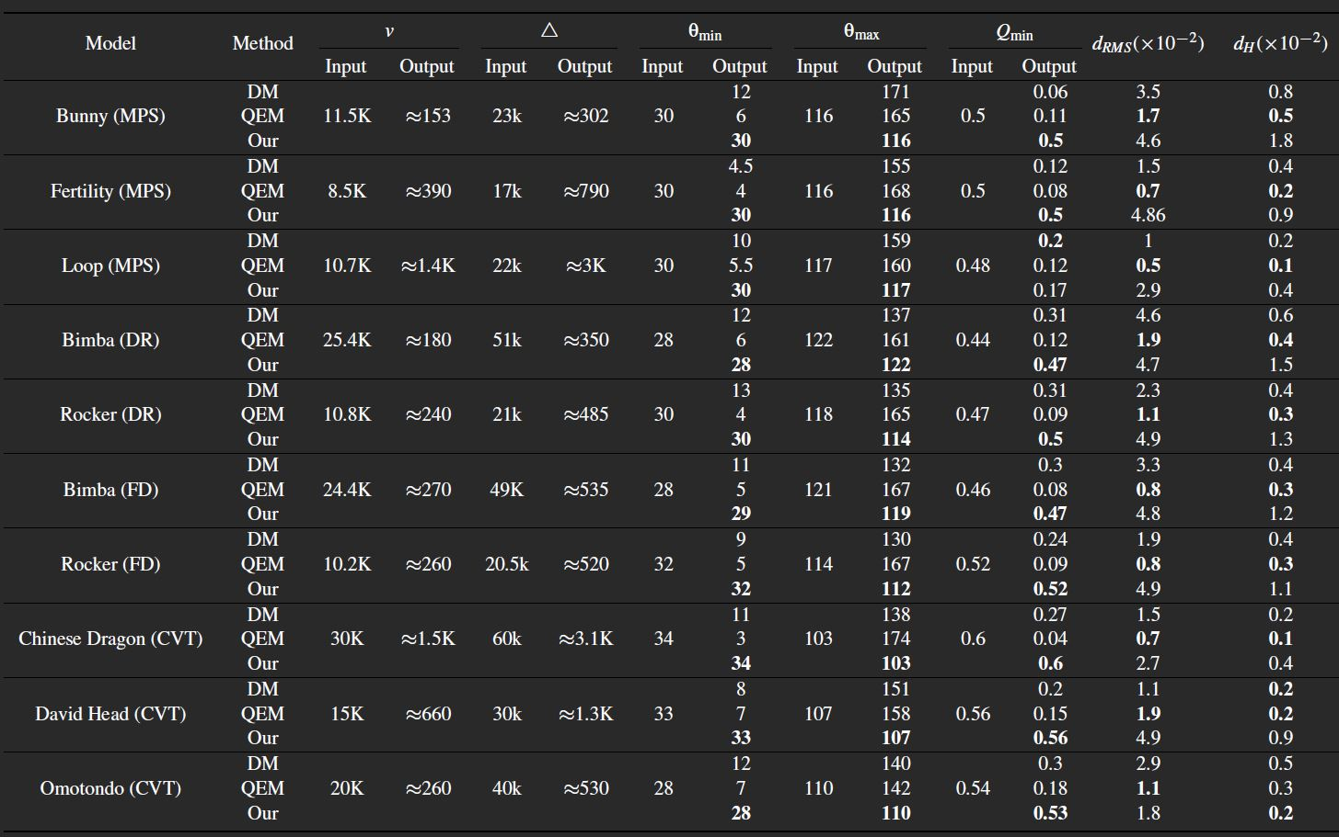
Applications
4- Mesh Simplification
Min Angle
Max Angle
Hausdorff Distance
“Surface Simplification Using Quadratic Error Metric” – Garland M.,et al. -
SIGGRAPH '97
“Efficient Construction and Simplification of Delaunay Meshes” – Liu Y.-J., et al. -
TOG 2015
Notes:
Mesh Simplification results (Section 5.1)
We compared our mesh simplification algorithm against the popular Quadratic Error Metric and the Efficient Construction and Simplification of Delaunay Meshes (referred to as DM). As shown in the table, the QEM is always better in terms of Hausdorff distance across all model, while the DM comes second in place and our comes last. However, our algorithm still produces acceptable values for Hausdorff distance and the visual appearance is still acceptable (as indicated from the models). Additionally, the quality of the output from our algorithm is always better.

Slide 45
The Strategy
Input:
Triangular mesh & quality objectives
Curved Surface mesh
Planar 2D Mesh
Minimum and maximum angle bound
Delaunay property
Sizing function
Notes:
What is the input for our strategy

Slide 46
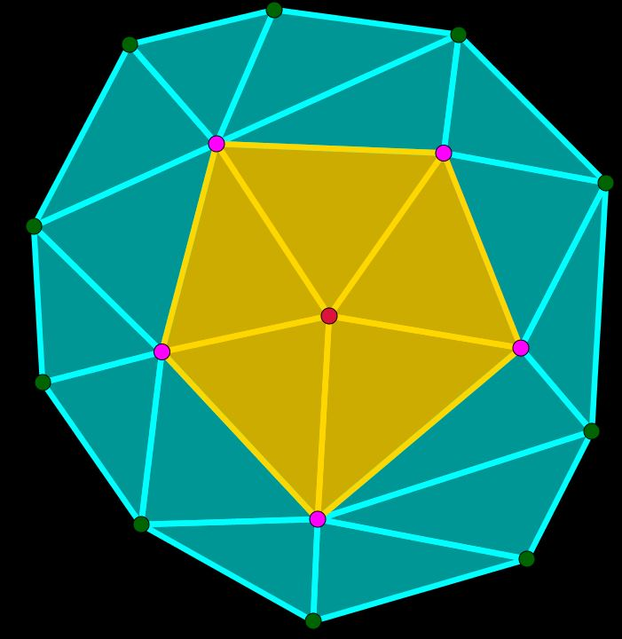
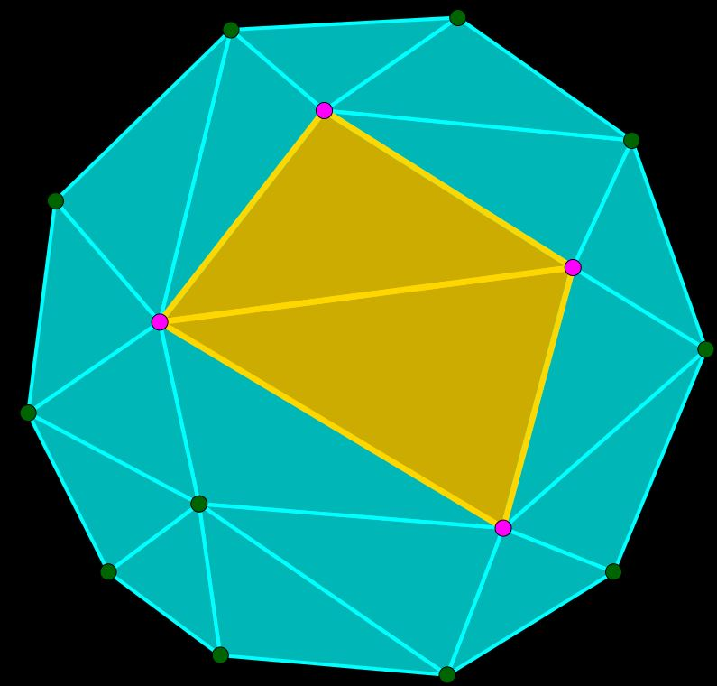
The Strategy
Definitions:
- Patch:
Two Opposite Triangles
Triangle Fan
Notes:
Steps (Section 3.)
Second definition is a mesh patch or a patch. This is any group of mesh elements and its associated vertices and edges. This could be two opposite triangles and a triangle fan or maybe a triangle strip.

Slide 47
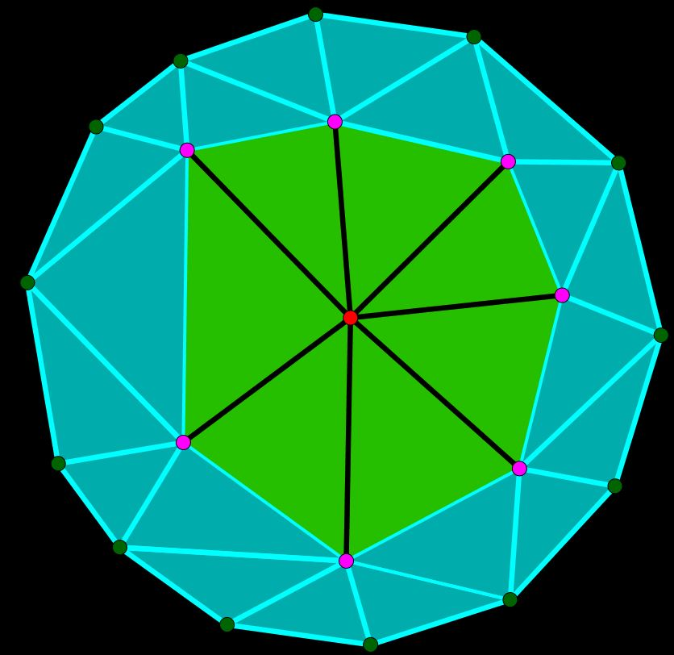
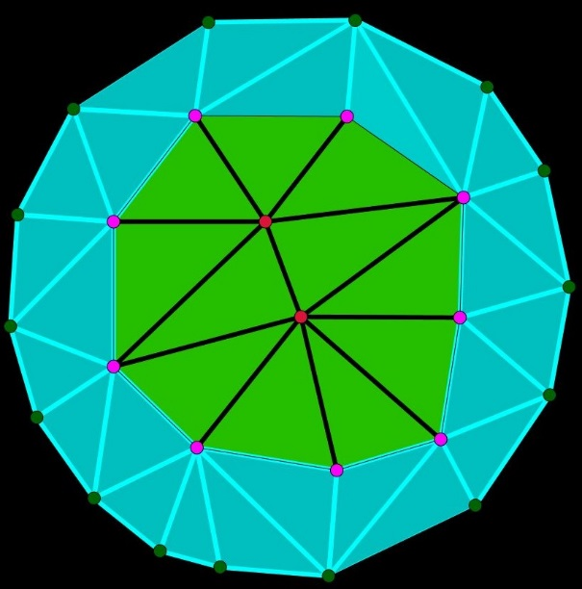



The Strategy
Definitions:
- Void:
neighbors
void
void
Notes:
Steps (Section 3.)
This definition is a void. A void is created in the mesh by removing some mesh elements. In most cases we remove one or two vertices and this creates the void as show here.

Slide 48
The Strategy
Steps:
1- Pick a patch where quality objectives not satisfied
2- Delete all elements on this patch (void)
3- Map quality objective into geometric constraints (feasible region)
4- Sample from the feasible region and triangulate
5- Iterate over all mesh patches until no further improvement is
possible
Notes:
Steps (Section 3.1)
The high-level description of the strategy steps is as following:
1- We start by picking a mesh patch that violates the user objectives (head of obtuse triangle for non-obtuse remeshing)
2- We then delete the elements of this patch which creates a void in the mesh. We hope to sample this void with at most one sample such that after sampling, all user objectives are satisfied. In other words, we will try to explore a feasible region within the void such that all user objectives are satisfied locally for this patch.
3- In order to tighten the void of sampling or, in other words, guide the sampling process, we use geometric primitives (e.g., spheres, planes) that are constructed by mapping the user objectives into geometric primitives (will be explained in details later). These geometric primitives defines the feasible region. In cases where the feasible region is empty, we return the original patch as it was and move on to another patch.
4- Other wise, we sampling the void guided by the geometric constraints and then retriangulate the void. Note here that we usually sample only one vertex which simplify the implementation. However, this require carful selection of the mesh patch such that the quality objectives are satisfied using one vertex.
5- We iterate over all mesh patches, at each mesh patch we test for the user objectives, if the mesh patch violate any of them we go to 1.
Next we will focus on step (3) and (4) which are the two most crucial steps in our stagey and they differ from algorithm to another.

Slide 49




The Strategy
Quality Objectives → Geometric Primitives:
a) Exclusion region:
red= exclusion region
void
patch associated with bad element
removing patch elements creates void
map quality objective (non-obtuseness) for a single segment
map quality objective from all segments
Notes:
Mapping quality objective into spatial constraints (Section 3.2)
As mentioned, we use these geometric primitives to define the feasible region. Such a region can be categorized into exclusion region and inclusion region. The exclusion region is a region that should not contain the new sampled vertex in order to satisfy the quality objectives in hand. For example, the Delaunay property requires that all existing triangles’ circumcircles should be empty, such circumcircles can be used as exclusion region. The example shown here is for a patch that contains an obtuse triangle. So we start by deleting all elements in the patch which creates a void. In order to make sure that the new sampled vertex does not have an obtuse angle at its apex, it should be outside all diameter circles of the void edges which is mapped as shown here into an exclusion region

Slide 50


The Strategy
Quality Objectives → Geometric Primitives:
a) Inclusion region:
hatch= inclusion region
void
θ_{min}
θ_{min}
patch associated with bad element
removing patch elements creates void
map quality objective (min angle) for a single segment
map quality objective from all segments
Notes:
Mapping quality objective into spatial constraints (Section 3.2)
The inclusion region on the other hand is the region that should contain the new sampled vertex. For example, in order to maintain a bound on the minimum angle, the two vertices of the bottom edge should be connected to a vertex lies in the hatch region to make sure that both the base angles are larger than the minimum angle. Thus, for each edge we use two half-planes. The intersection of all half-planes for all edges surrounds the void gives the polygon shown.

Slide 51

The Strategy
Quality Objectives → Geometric Primitives:
Exclusion & Inclusion regions:
hatch= inclusion region
red = exclusion region
Notes:
Mapping quality objective into spatial constraints (Section 3.2)
Thus, the feasible region is the union of all exclusion regions and the intersection of all inclusion regions and for the two quality objectives we discussed, it will look like this. This is too complicated specially with increasing the quality objectives desired and when applied on curved surfaces. Thus we don’t construct the feasible region explicitly like this. Instead, we use the simple primitives only (sphere, half planes) which is cheaper to construct and check the sampled vertex against each primitive at a time which simplifies the implementation.

Slide 52
The Strategy
Steps:
1- Pick a patch where quality objectives not satisfied
2- Delete all elements on this patch (void)
3- Map quality objective into geometric constraints (feasible region)
4- Sample from the feasible region and triangulate
5- Iterate over all mesh patches until no further improvement is
possible
Notes:
Resampling Operators (Section 3.3)
Going back to the steps, we are now left with the sampling procedure in step (4), which we are going to discuss next.

Slide 53

The Strategy
Resampling Operators:
1) Relocation
Notes:
Resampling Operators (Section 3.3)
For sampling, we use five different operators that provide the versatility required for different algorithms. The simplest one is the relocation operator. In this operator, we remove one vertex and sampled one vertex which can be viewed as relocating the vertex. In the figure show, the red circles can be viewed as exclusion region and the green area is the inclusion region. Thus, resampling the white vertex outside the exclusion region and at anywhere in the inclusion region would achieve the desired quality.

Slide 54

The Strategy
Resampling Operators:
2) Ejection
Notes:
Resampling Operators (Section 3.3)
The second operator is the ejection operator. In this operator, we remove or eject two (or maybe three) vertices and try to sample a single vertex that would achieve the quality object desired. One or both of the ejected vertices should be violating the quality objective. As shown here, the left white vertex is inside the exclusion region. Removing it along with another vertex and sample a single vertex achieves the quality objective. We use this operator for mesh simplification and Delaunay sifting where any two connected vertices can be ejected. This similar to edge collapse. However, using sampling, we explore a better place for the new vertex to be placed (rather than deterministic decision in edge collapse)

Slide 55



The Strategy
Resampling Operators:
3) Injection
tri-valent vertex
bad element
Notes:
Resampling Operators (Section 3.3)
Third operator is injection. This is the opposite of ejection where, here, we increase the vertex count. So, after selecting a bad element, we can insert a vertex in the middle of this element. But this will create a tri-valent vertex is always not desired in triangular meshes.

Slide 56

The Strategy
Resampling Operators:
3) Injection
bad element
bad element
Notes:
Resampling Operators (Section 3.3)
Thus, we use this template where we propagate across the edges of the bad elements and remove two edges and sample a new vertex in the newly created void. The inserted vertex is now of valence five.

Slide 57


The Strategy
Resampling Operators:
4) Attractor Ejection
Notes:
Resampling Operators (Section 3.3)
We use two more aggressive operators that can be viewed as combination between relocation and ejection and relocation and injection. The forth operator is called attractor ejection. In this operator, we use the relocation to attract or relocate the void neighbor vertices toward the center of the void. This way we can tighten the void which make the process of replacing two vertices by one (ejection) possible for many occasions.

Slide 58


The Strategy
Resampling Operators:
5) Repeller Injection
bad element
bad
element
Notes:
Resampling Operators (Section 3.3)
The final operator we use is called repeller injection. With this operator, we combine the relocation and injection operator such that we relocate the neighbor vertices further away from the void which create a wider void which makes it possible to insert a new vertex. We note that for both repeller injection and attractor ejection, when we relocate the neighbor vertices, we don’t create bad elements in the neighborhood. Thus, if applying the operator is done successfully, we are certain that the resulting patch is improve.

Slide 59



The Strategy
Sampling:
dart throwing
void
coarse grid
refined grid
Notes:
Sample from the feasible region (Section 4.3)
All operators we use include sampling a vertex in the created void. We use the dart throwing approach in order to sample a vertex inside the feasible region. Thus, after creating the void and constructing the geometric primitive by mapping the quality objectives, we construct a coarse grid that capture the whole void. We iteratively throw darts from the grid, and check it against all the geometric primitives. If the candidate dart is outside all exclusion regions and inside the union of the inclusion regions, the dart is accepted and we insert it and connect it directly with the void neighbor vertices. If not, we try another dart. After a certain number of darts proportional to the grid size, we refine the gird cells by dividing each cells into four sub-cells and discard the sub-cells that are either completely inside the exclusion region or completely outside the inclusion region. We then repeat the dart throwing procedure till we find an acceptable vertex or the gird cells is exhausted which indicate that the feasible region is empty and we return the original patch.
This was an overview of the basic details about our strategy. In each of the application presented earlier, we either use a subset of the quality objectives and use subset of the operators. In some applications we used all the operators such as non-obtuse triangulation. The paper contains more details about the sampling operators, quality objectives we consider for each application, and the scheduling of the sampling operators.

Slide 60
Problem Definition (Revised)
Improving an input mesh in terms of a given set of quality objectives
How to translate the quality objectives?
How to achieve multiple objectives ?
Map quality objectives into geometric constraints
Use local resampling, constrained by the geometric primitives
Notes:
Going back to the first slide to answer the questions we raised.
So, in order to build a single strategy that can address multiple objective at one time, we used the mapping of quality objectives into geometric primitives which can be constructed trivially for large set of objectives and can be efficiently stored and operated upon. And to effectively achieved multiple objectives, we used local resampling where we utilized five different operators that provided enough flexibility for different objectives. The local resampling is constrained by the geometric primitives in order to ensure addressing the right objective locally.

Slide 61
The Strategy
Guarantees:
- No degradation
- No repeated scenarios guarantees termination
- For curved surface, sampling from the input
surface guarantees upper bound on Hausdorff
distance
Notes:
Guarantees (Section 6.1)
Our proposed strategy comes with some guarantees. First, we guarantee that the output mesh at least as good as the input mesh, means no degradation is allowed to the input mesh since when we construct the geometric constraints we make sure that the neighbors are not affect. Second, the algorithm is guaranteed to terminate since we only re-visit a patch if its topology has changed. Finally, for curved surface, we map the sampling gird over the original surface and we use triangular cells instead of squares, this guarantee an upper bound over the Hausdorff distance between the remeshed output and the original mesh. This can be viewed form the results in the paper where we report the Hausdorff distance for all remeshed curved surface models.

Slide 62



The Strategy
Limitations:
- Stuck in local minima
Input
Dead-end
Success
Notes:
Limitations (Section 6.2)
However, our strategy does not guarantee that the output mesh is always improved. Using resampling, it is possible to get stuck in a local minima where some of the mesh elements are improvement but other can no longer be improved. We use the coarse input mesh shown here to illustrate this. On the second figure, our algorithm was able to get rid of all obtuse triangles but two were left unresolved where any operator was unsuccessful in eliminating them. The gateway for such cases is to re-run the algorithm again on the input mesh with different random seed. The random seed will change the order of selecting the next patch to process and the vertex being sampled. This is what happened and shown in the third figure.

Slide 63
Summary
- Simple strategy with versatile applications
- Derived spatial representation of various qualities
- Developed a toolbox for local resampling
- Demonstrate success over wide range of applications
Notes:
Concluding remarks (Section 7)
As a conclusion, I would like to wrap up what we proposed. The strategy uses simple steps in order to achieve different applications. In each of these applications, we showed what advantages we can achieve over the previous art. We derived an easy way to represent various mesh qualities into spatial representation which is cheap to be constructed. These spatial representation are than used within a sampling procedure that is capable of capturing hard-to-obtain solution.

